Slide 2
Data Link Control
Chapter 10
By
Waleej Haider
Razia Nisar
Sana Ejaz

Slide 3
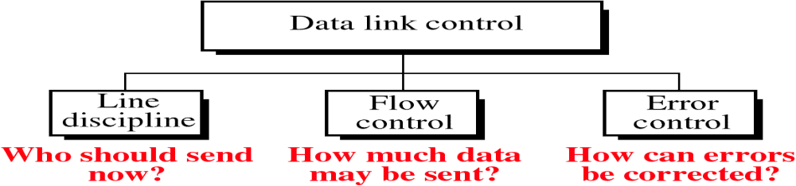
Flow control
refers to a set of procedures used to restrict the amount of data that
the sender can send before waiting for acknowledgment.
Error control
in the data link layer is based on automatic repeat request, which is the retransmission of data

Slide 4
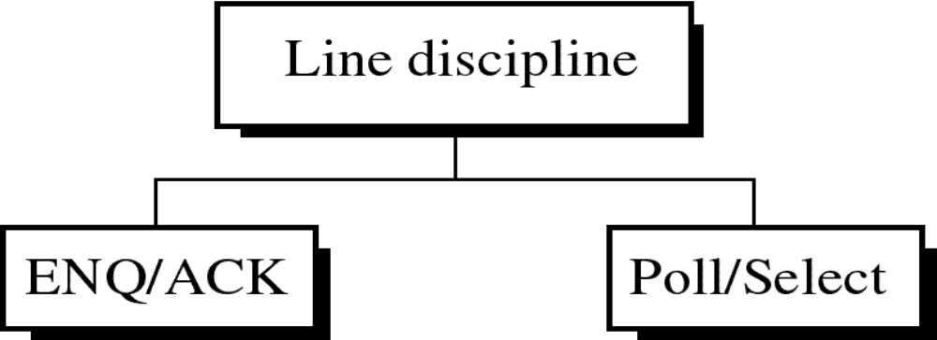
Line discipline
It determines which device can send and when it can send.
It oversees the establishment of links and the right of a particular device to transmit at a given time.

Slide 5
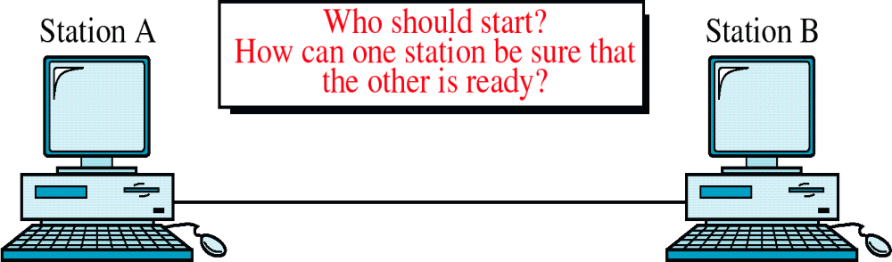
Enquiry / Acknowledgment
ENQ/ACK

Slide 6
ENQ/ACK
  It is used in systems where there is no question of the wrong receiver getting the transmission
  i.e. when there is a dedicated link between two devices so that the only device capable of receiving data is the intended one.
The initiator sends ENQ
The receiver sends ACK
The receiver sends NAK
No response
Send data till EOT
Repeat three times
Repeat three times
Disconnect
Disconnect
and start again at
another time
Disconnect

Slide 7
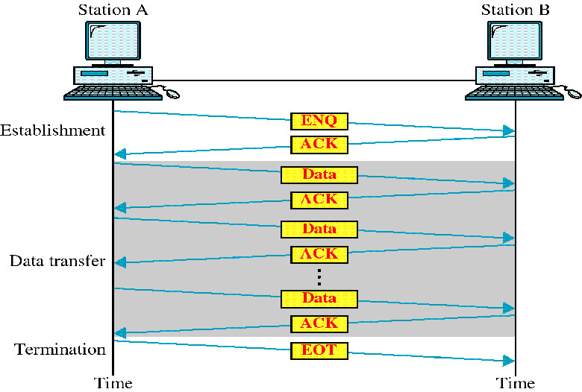
ENQ/ACK

Slide 8
Poll / Select
It works with topologies where one device is designated as a primary station and the other devices are secondary stations and all are using a single transmission line.
All data communication must be made through the primary device
If the primary wants to receive data, it asks the secondaries if they have anything to send; this function is called polling.
If the primary wants to send data, it tells the target secondary to get ready to receive; this function is called selecting

Slide 9
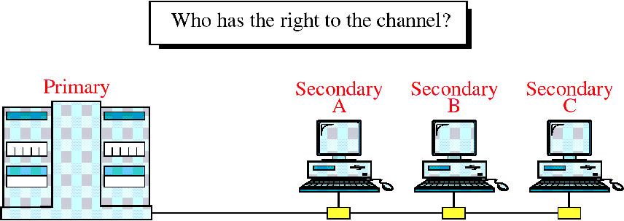
Multipoint Discipline

Slide 10
Addresses
We need addressing for multipoint transmission.
Each secondary device has an address that differentiates it from the others.
If the transmission comes from the primary device, The address indicates the recipient of the data.
If the transmission comes from a secondary device, the address indicates the originator of the data.

Slide 11
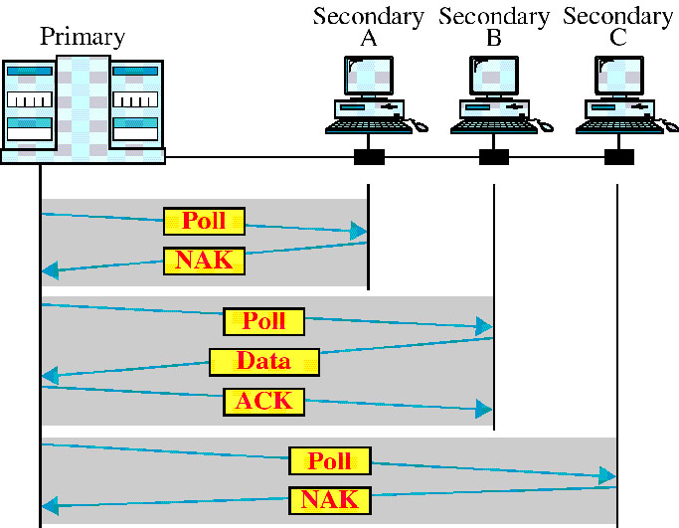
Poll
It is used by the primary device to solicit transmissions from the secondary devices.
There are two possibilities for terminating the exchange
  The secondary sends all its data and sends (EOT) frame
  The primary “Time’s up”

Slide 12
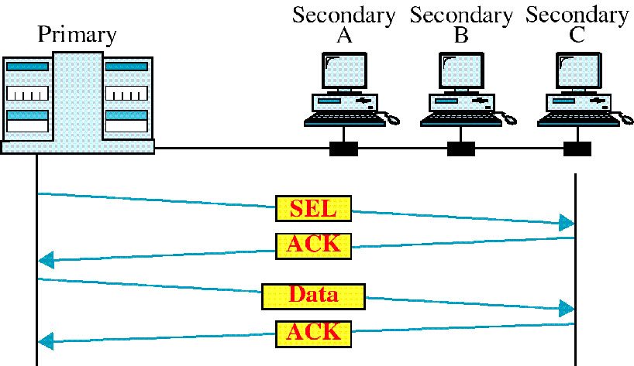
Select
It is used whenever the primary device has something to send.
Any frame on the link is available to every device.
When a device recognizes its own address, it opens the frame and reads the data.

Slide 13
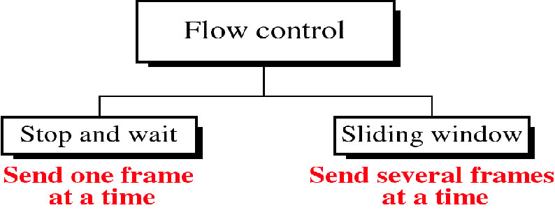
Flow control
It coordinates the amount of data that can be sent before
receiving acknowledgment.
It provides the receiver’s acknowledgment of frames
received corrupted.

Slide 14
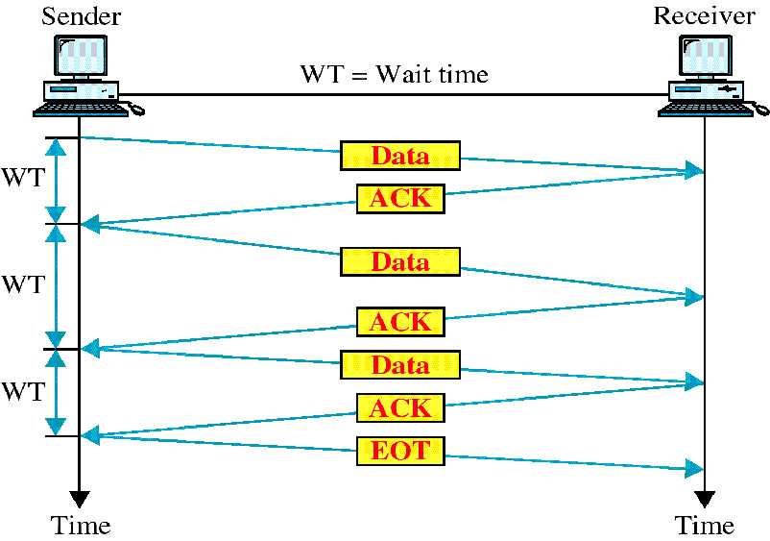
Stop and Wait

Slide 15
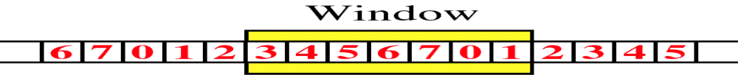
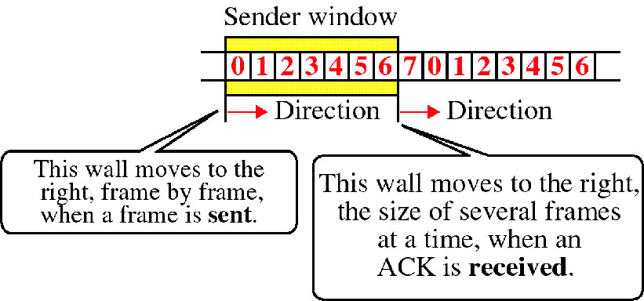
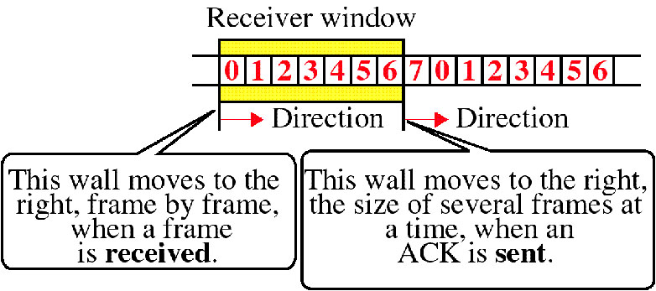
Sliding Window
Sender Sliding Window
Receiver Sliding Window

Slide 16
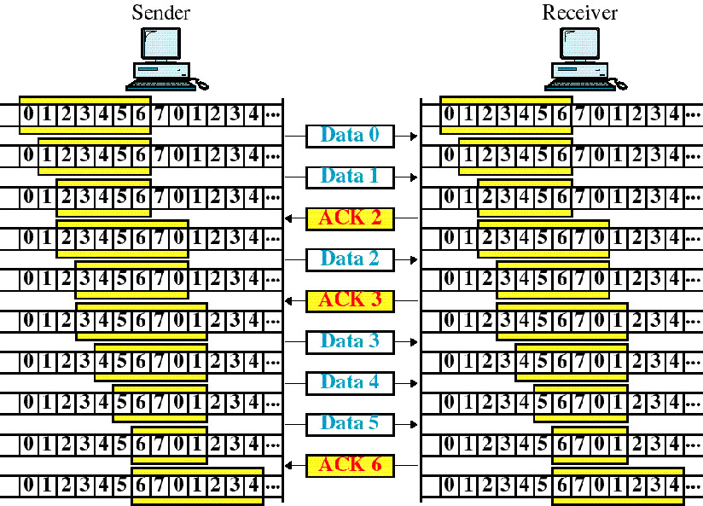
Sliding Window Example

Slide 17
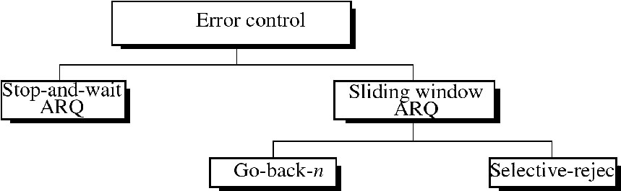
Error Control

Slide 18
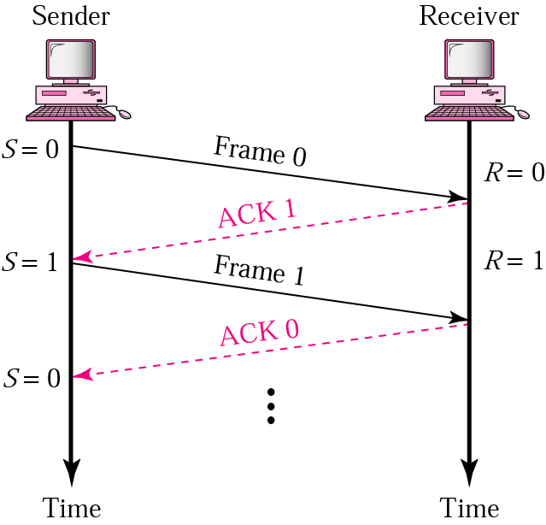
Normal operation
In Stop-and-Wait ARQ, numbering frames prevents the retaining of duplicate frames.

Slide 19
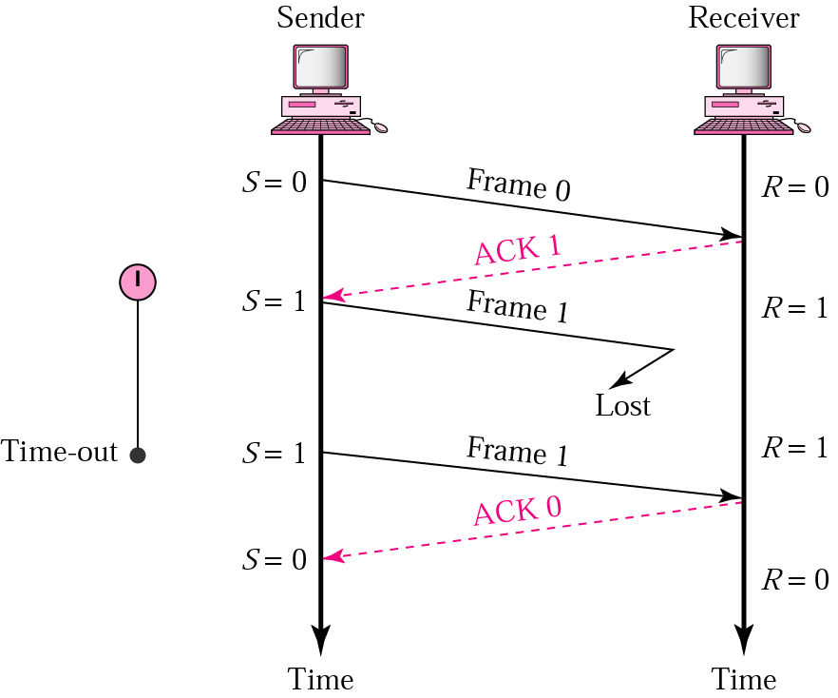
Stop-and-Wait ARQ, lost frame

Slide 20
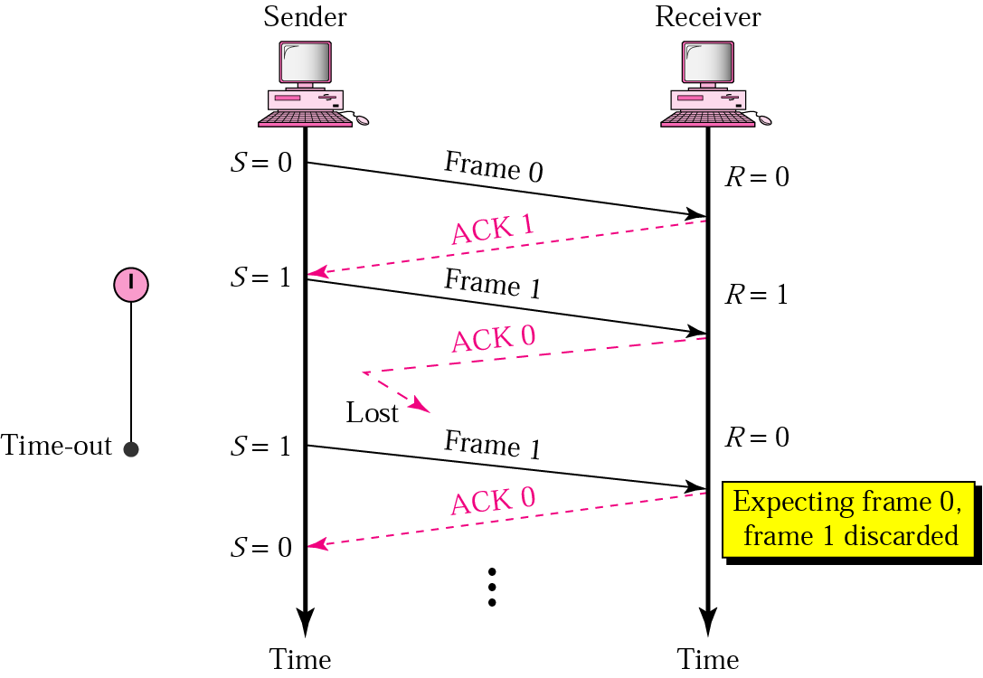
Stop-and-Wait ARQ, lost ACK frame

Slide 21
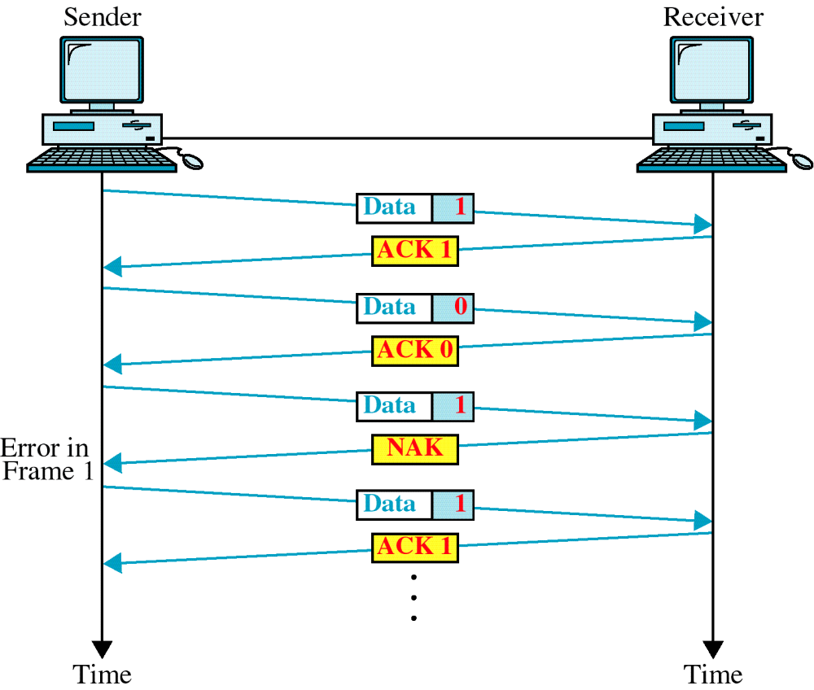
Damaged Frame

Slide 22
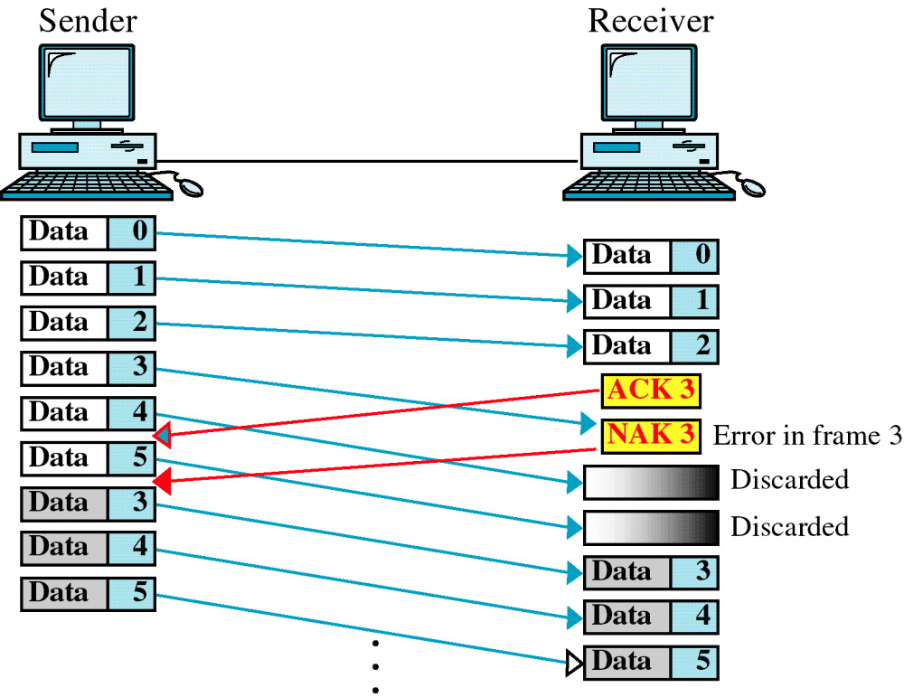
Damaged Frame

Slide 23
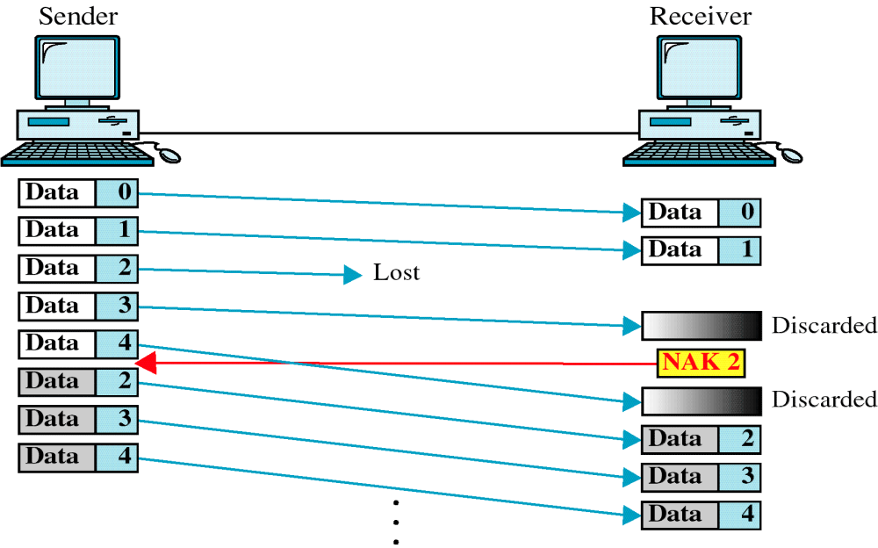
Lost Frame

Slide 24
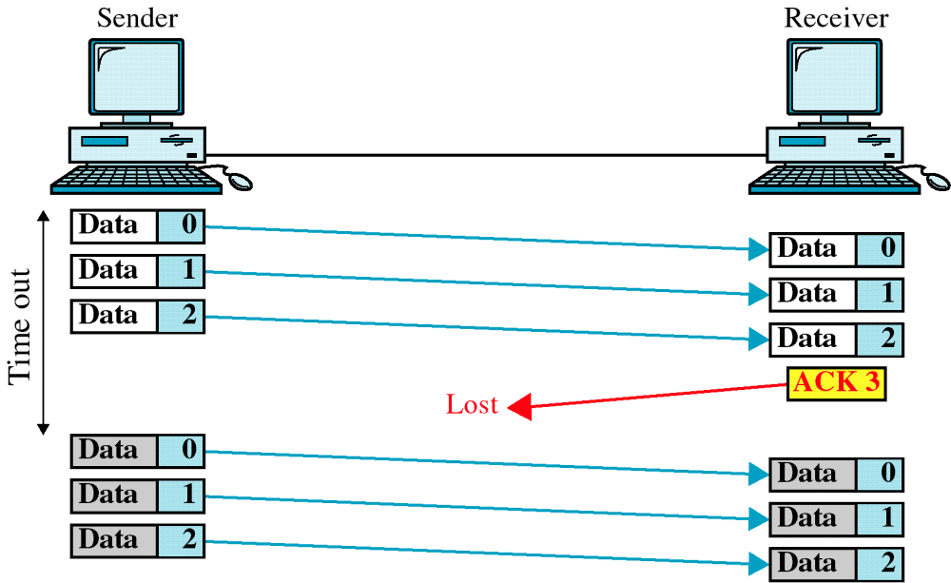
Figure 10-21
Lost ACK
WCB/McGraw-Hill
© The McGraw-Hill Companies, Inc., 1998

Slide 25
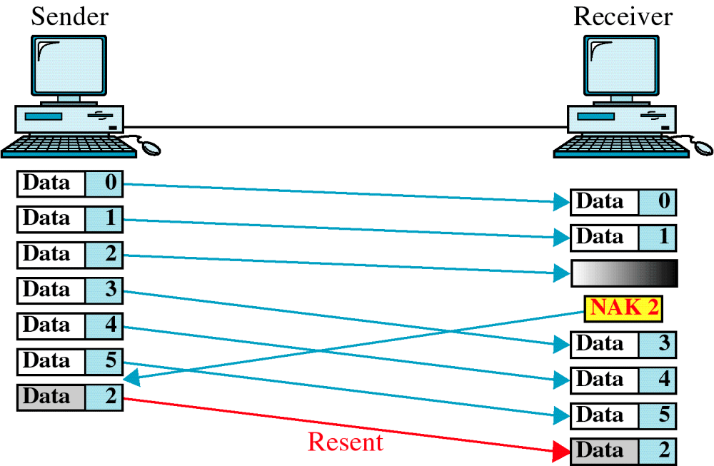
Figure 10-22
Selective Reject
WCB/McGraw-Hill
© The McGraw-Hill Companies, Inc., 1998

Slide 26
Data Link Protocols
Is a set of specifications used to implement the data link layer
Data link protocols differ by message delineation, frame length, and frame field structure.
Another fundamental difference is between asynchronous and synchronous transmission data link protocols.

Slide 27
Asynchronous Protocols
In asynchronous transmission (sometimes called start-stop transmission), each character is sent independently.
The transmission sequence begins with
  a start bit
  next the character is sent
  then the parity bit
  and finally a stop bit are sent.
    The start bit is usually a 0 and the stop bit a 1.
Between transmissions (called “idle time”), a series of stop bits are sent.
When a new character is sent, the start bit is used by the receiver for synchronization.

Slide 28
Asynchronous Protocols
Protocols that belong to asynchronous protocols
    XMODEM
    YMODEM
    ZMODEM
    BLAST
    Kermit

Slide 29
Synchronous Protocols
In synchronous transmission
  data is sent in a large block called a frame
Synchronous transmission is used on both
  point-to-point
  multipoint circuits
    In multipoint circuits, addressing information needs to be included in the frame.
Synchronous packets sometimes begin and end with a series of synchronization (SYN) characters that are used to help the receiver recognize incoming data.

Slide 30
Synchronous Protocols
Synchronous transmission protocols can be:
  character-oriented:
    Also known as byte-oriented protocols
    Interpret a transmission frame as a succession of characters
  bit-oriented:
    Interpret a transmission frame as a succession of individual bits
    Control information in a bit-oriented protocol can be one or multiple bits depending on the information embodied in the pattern

Slide 31
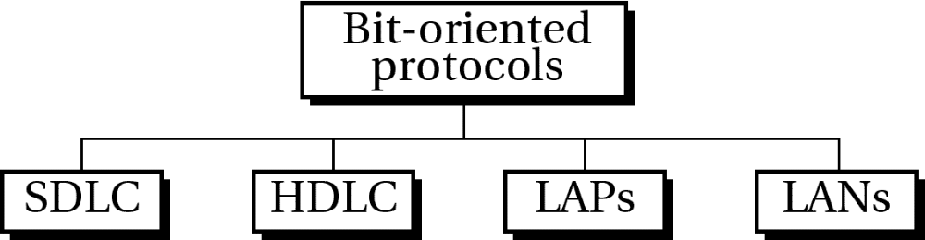
Bit-oriented protocols

Slide 32
HDLC : High-level Data Link Control
It is a bit-oriented data link protocol
Designed to support both half duplex and full duplex
communication over point-to-point and multipoint links.
It implements the ARQ mechanisms.
The HDLC protocol embeds information in a data frame
that allows devices to control data flow and correct errors

Slide 33
HDLC : High-level Data Link Control
In 1979, the ISO made HDLC the standard as a Bit-oriented control protocol
The HDLC provides a transparent transmission (شفّاف) service at the data link layer of the OSI
The users of the HDLC service provides PDUs which are encapsulated to form data link layer frames. These frames are separated by HDLC "flags" and are modified by "zero bit insertion" to guarantee transparency

Slide 34
HDLC : High-level Data Link Control
Each piece of data is encapsulated in an HDLC frame by adding a trailer and a header.
The header contains an HDLC address and an HDLC control field.
The trailer is found at the end of the frame, and contains a (CRC) which detects any errors which may occur during transmission.
The frames are separated by HDLC flag sequences which are transmitted between each frame and whenever there is no data to be transmitted.

Slide 35
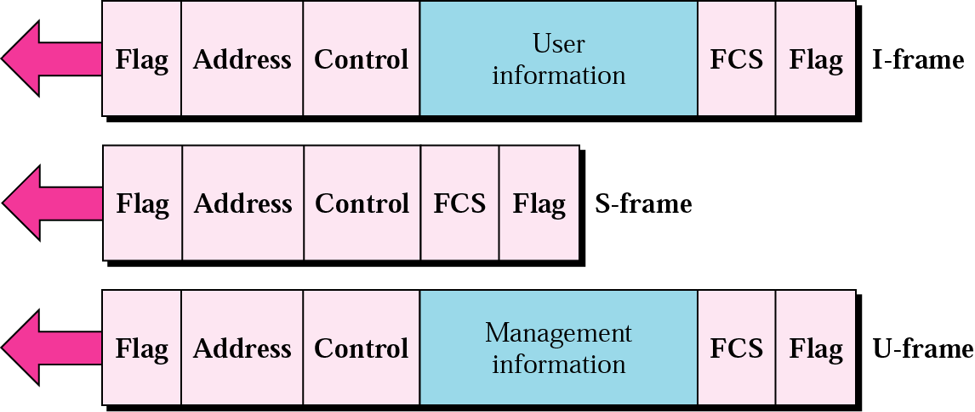
HDLC frame types

Slide 36
HDLC Frame Fields
Flag field
  is 8 bits of a fixed pattern (0111 1110).
  There is one flag at the beginning and one at the end frame.
  The ending flag of one Frame can be used as the beginning flag of the next frame.
  To guarantee that the flag does not appear anywhere else in the frame
  HDLC uses a process called Bit Stuffing.
  Every time a sender wants to transmit a bit sequence having more than 6 consecutive 1’s, it inserts 1 redundant 0 after the 5_{th} 1
    Exceptions:
    When the bit sequence is really a flag.
    when transmission is being aborted.
    when the channel is being put into idle.

Slide 37
Bit Stuffing
the process of adding one extra zero whenever there are 5 consecutive 1’s in the data, so that the receiver doesn’t mistake the data for a flag.
A frame before bit stuffing:
01111110 01111100 101101111 110010
After
011111010 011111000 101101111 1010010

Slide 38
How does the receiver identify a stuffed bit?
Receiver reads incoming bits and counts 1’s.
When number of consecutive 1s after a zero is 5, it checks the next bit (7th bit).
If 7th bit = zero ➔ receiver recognizes it as a stuffed bit, discard it and resets the counter.
If the 7th bit = 1 ➔ then the receiver checks the 8th bit; If the 8th bit = 0, the sequence is recognized as a flag.
01111010 011111000 101101111 1010010

Slide 39
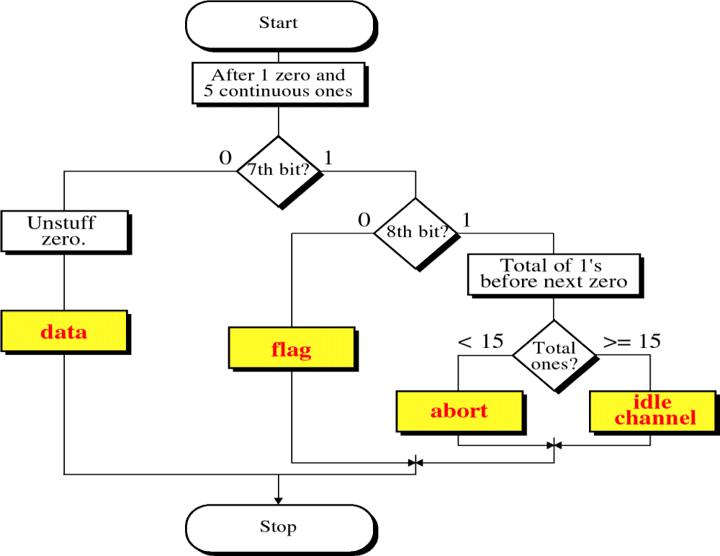
How does the receiver identify a stuffed bit?

Slide 40
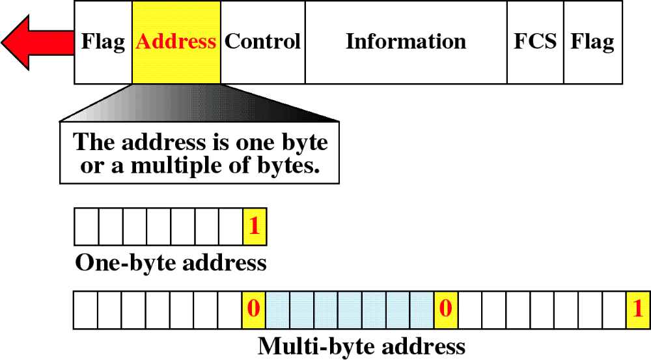
Address field
Address field is one byte or more
If the address is more than one byte, all bytes will end with 0,except the last one

Slide 41
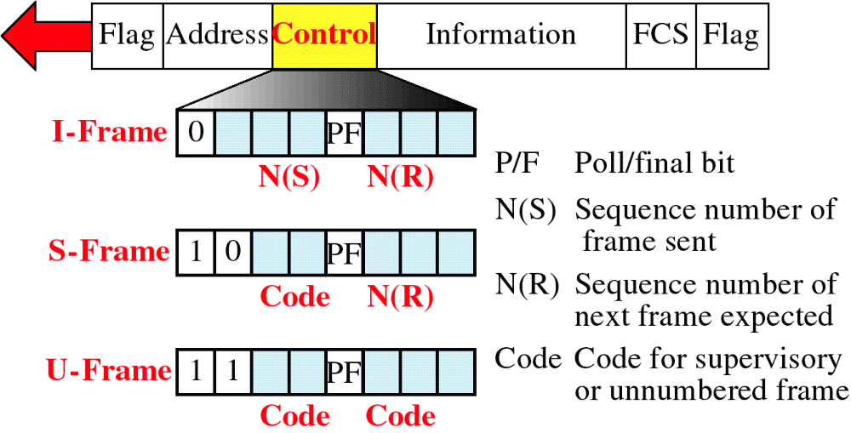
HDLC Control Field

Slide 42
Control Field
all three types contain a bit called (Poll/Final) P/F bit
I-Frame
N(S) : sequence # of the sent frame
N(R) : sequence # of frame expected in return
    ➔ N(R) is ACK field
If last frame received is error free ➔N(R) number will be the next frame in sequence
If the frame was not received correctly ➔ N( R) number will be the number of damaged frame indicating the need for retransmission

Slide 43
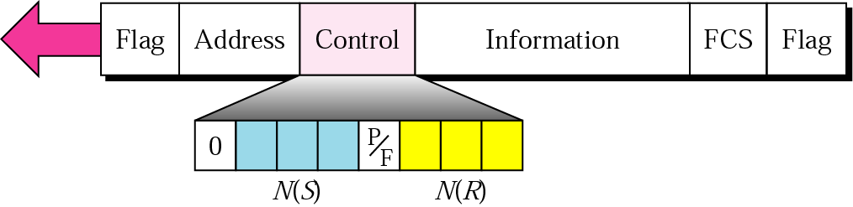
I frame

Slide 44
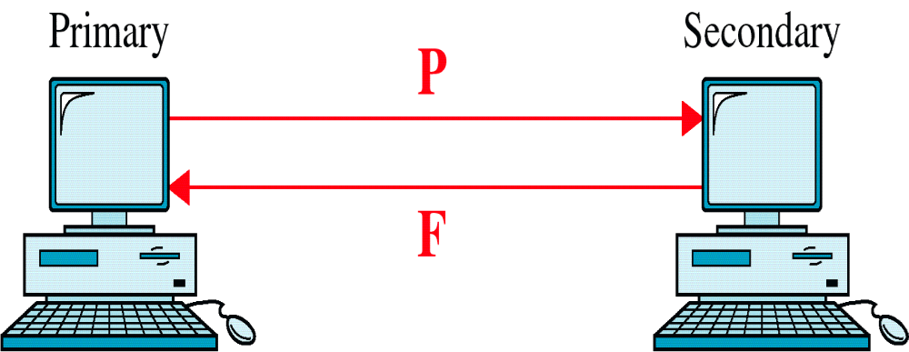
Poll/Final
P/F = 1 ➔POLL or Final
  Poll if frame is sent by the primary
  Final if frame is sent by the secondary

Slide 45
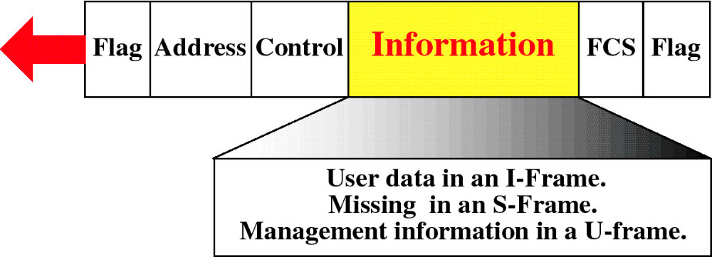
Information Field

Slide 46
Information Field
Contains user data in I-frame and network management information in a U-frame.
It is possible to include flow and error control information in an I-frame that also contains data.
In 2-way exchange of data (1/2 or full-duplex), the 2nd station can ACK receipt of data from the 1st station in the control field of its own data frame rather than sending a separate frame just for ACK.
Combining data to be sent & ACK of the frame received in one single frame is called PIGGYBACKING.

Slide 47
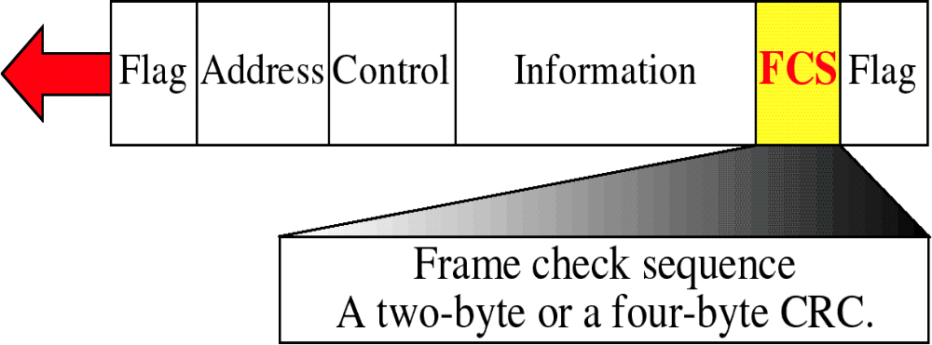
HDLC FCS Field

Slide 48
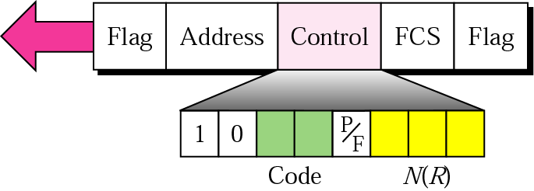
S-frame control field in HDLC

Slide 49
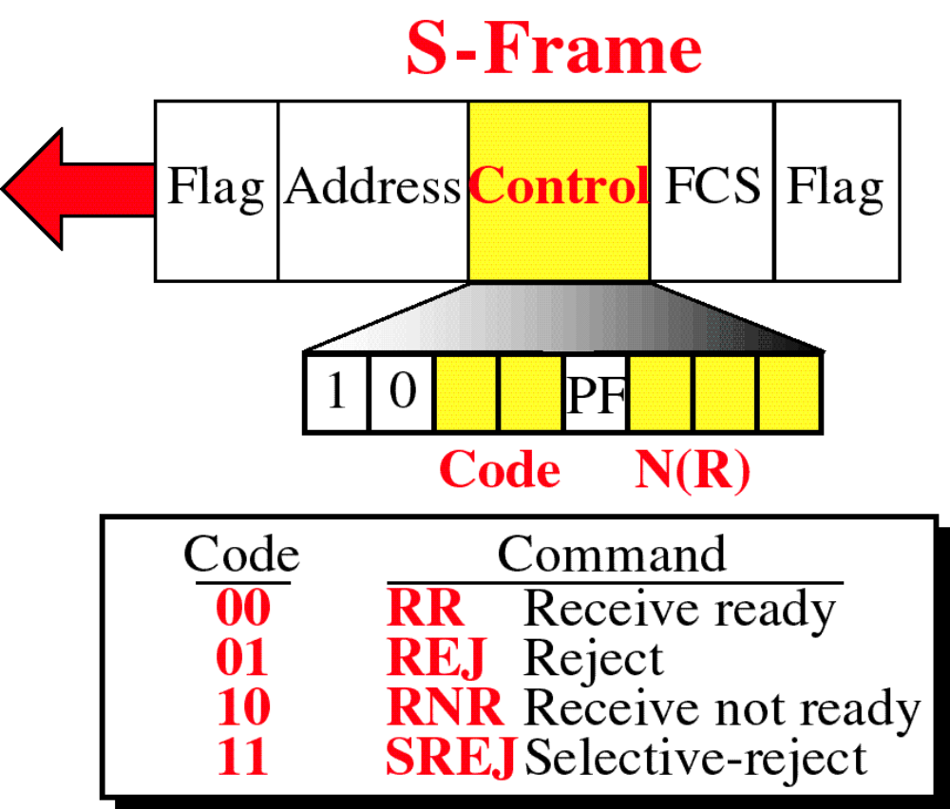

Slide 50
Receive Ready (RR)
  Positive ACK of a received I- frame
Receive Not Ready (RNR)
  Is RR frame with additional duties
  It Ack the receipt of a frame and announces that the receiver is busy
Reject (REJ)
  This is a NAK frame that can be used in Go-back-n
Selective reject (SREJ)
  This is a NAK frame used in Selective Repeat ARQ

Slide 51
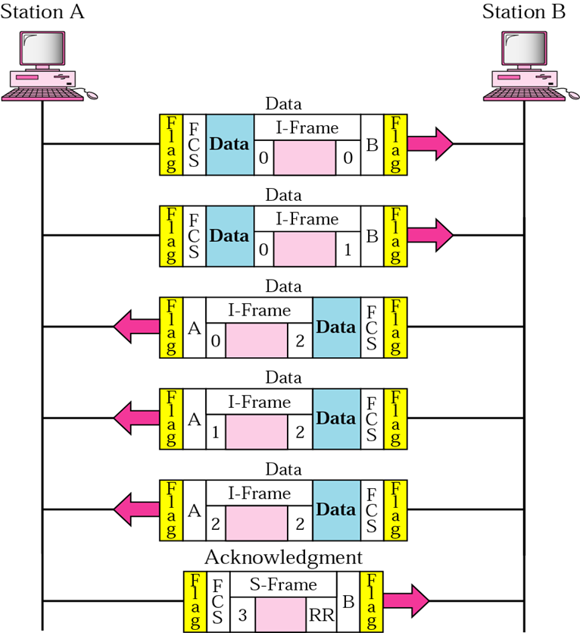
Example
The figure shows an exchange using piggybacking where is no error
  Station A begins the exchange of information with an I-frame numbered 0 followed by another I-frame numbered 1.
  Station B piggybacks its acknowledgment of both frames onto an I-frame of its own.
  Station B’s first I-frame is also numbered 0 [N(S) field] and contains a 2 in its N(R) field, acknowledging the receipt of A’s frames 1 and 0 and indicating that it expects frame 2 to arrive next.
  Station B transmits its second and third I-frames (numbered 1 and 2) before accepting further frames from station A.
  Its N(R) information, therefore, has not changed: B frames 1 and 2 indicate that station B is still expecting A frame 2 to arrive next.

Slide 52
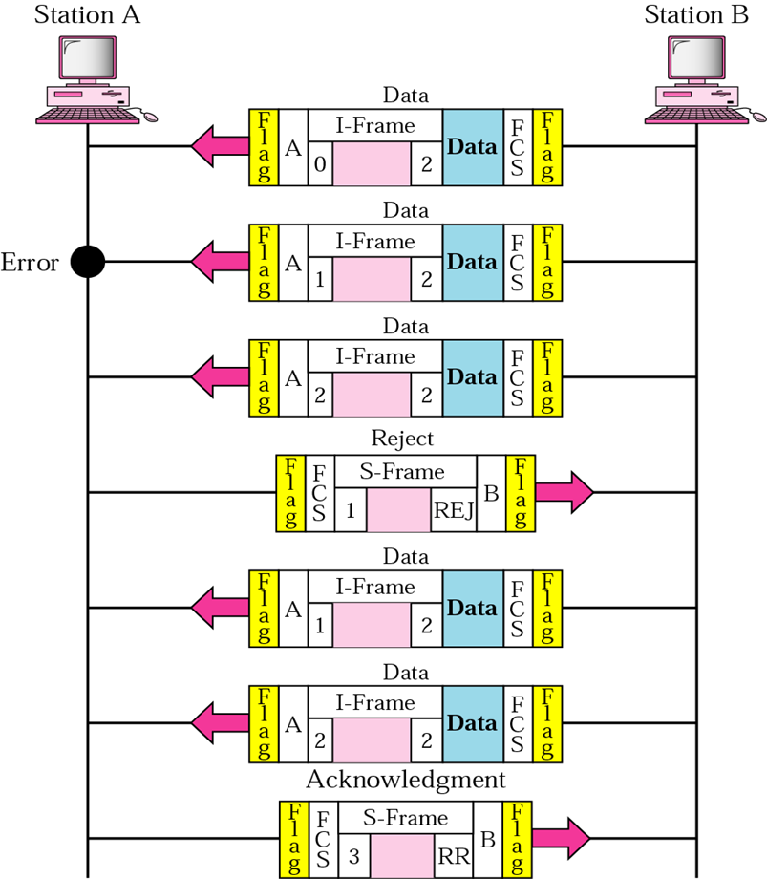
Example
In the previous Example, suppose frame 1 sent from station B to station A has an error.
Station A informs station B to resend frames 1 and 2 (the system is using the Go-Back-N mechanism)
Station A sends a reject supervisory frame to announce the error in frame 1

Slide 53
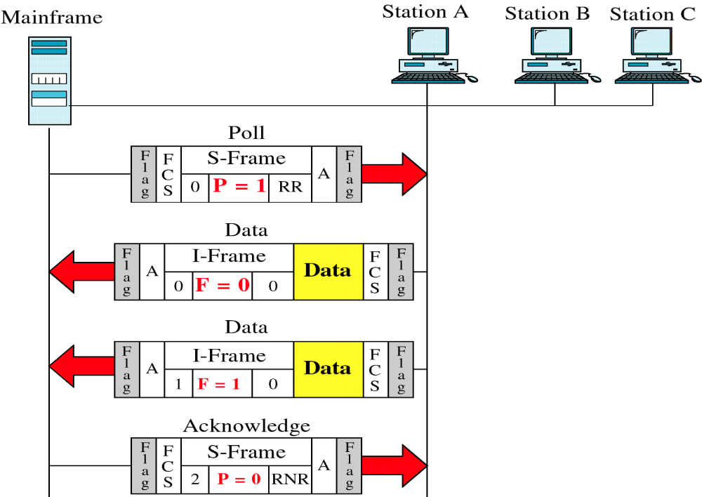
Polling Example
asking the secondary if it has anything to send

Slide 54
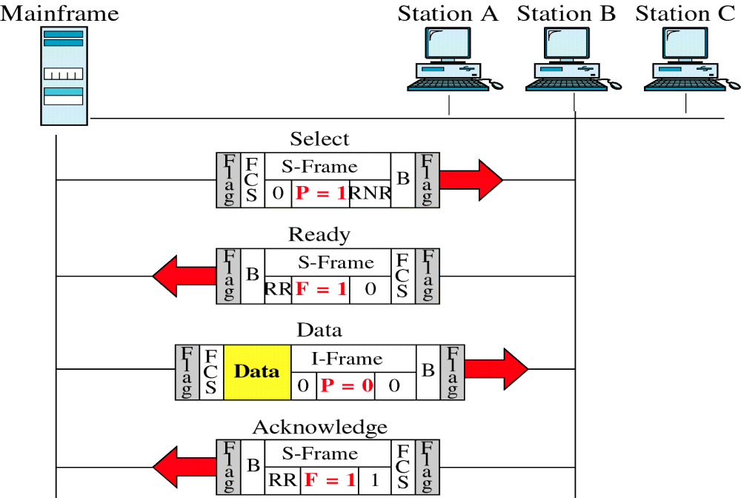
Selecting Example
A primary wishes to send data to secondary

Slide 55
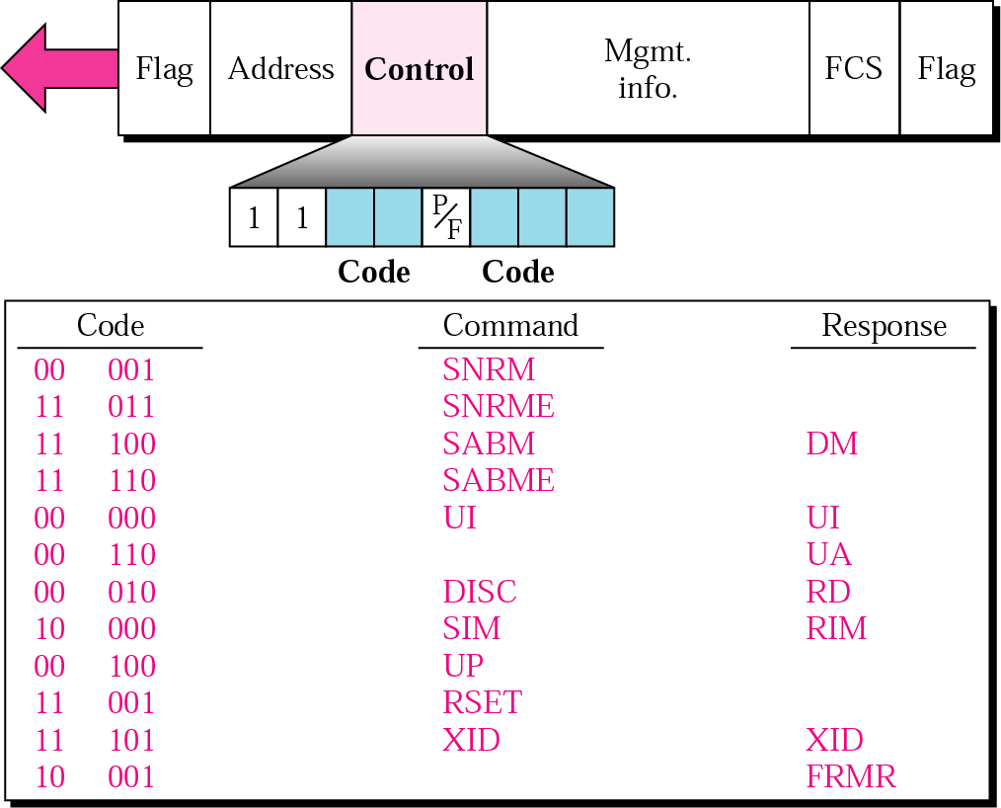
U-frame control field in HDLC

Slide 56
Table 11.1 U-frame control command and response
Command/response | Meaning
SNRM | Set normal response mode
SNRME | Set normal response mode (extended)– control field 2 bytes
SABM | Set asynchronous balanced mode
SABME | Set asynchronous balanced mode (extended)
UP | Unnumbered poll
UI | Unnumbered information
UA | Unnumbered acknowledgment
RD | Request disconnect
DISC | Disconnect
DM | Disconnect mode
RIM | Request information mode
SIM | Set initialization mode
RSET | Reset
XID | Exchange ID
FRMR | Frame reject

Slide 57
U-frame Mode setting
Mode-setting commands sent by the primary or combined station wishing to control an exchange
If a combined station wishes to establish a temporary primary-to-secondary relationship with another station it sends a U-frame containing code 00-001 (Normal Response Mode)

Slide 58
U-frame Disconnection
There three disconnection codes
  One command from acting primary or combined station
    disconnection (DISC 00 010) is sent by the 1st station to the 2nd station to terminate the connection
  Two responses from the receiving station
    request disconnect (RD 00 010) is a request by the 2nd station to the 1st that a DISC be issued.
    disconnect mode (DM 11 000) is transmitted by the addressed station as a negative response to mode-setting command

Slide 59
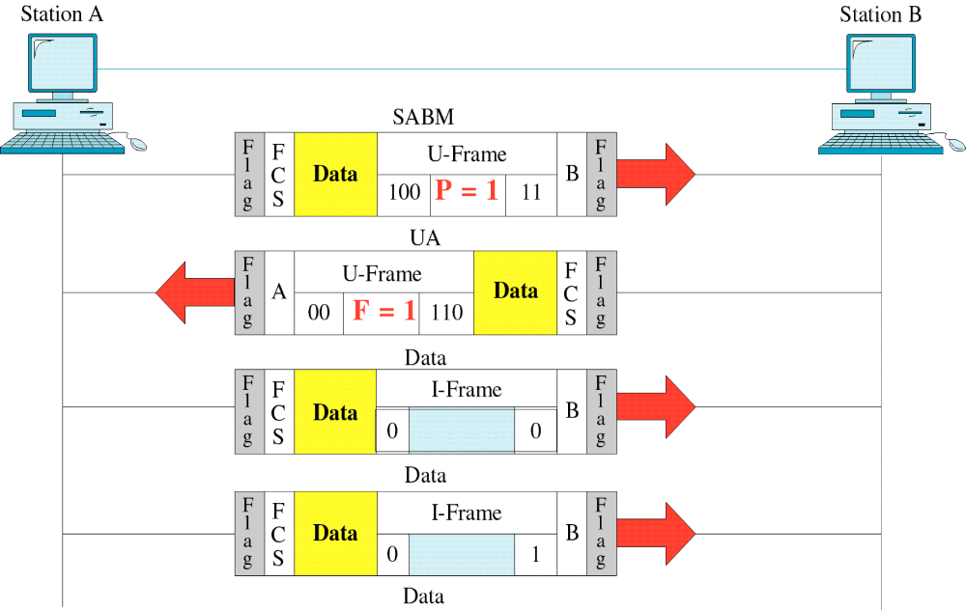
Peer-to-Peer Example
Set asynchronous balanced mode

Slide 60
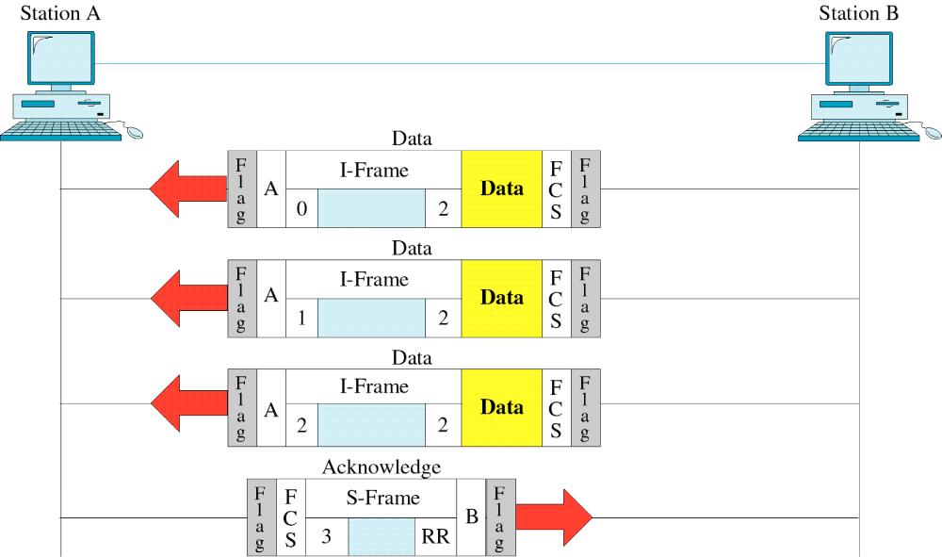
Continued
Peer-to-Peer Example

Slide 61

Example
The following HDLC frame is sent from the secondary to primary
(0111 1110 00001111 10001011 FCS 0111 1110)
a) What is the address of the secondary?
Answer: Address = 0000111 = 7
since Last bit of the address ends is 1 ➔this byte is last one in address field
Note: If the address is more than one byte, all bytes will end with 0, except the last one.
b) What is the type of the frame?
Answer: 10 in control field indicates, that this is a supervisory ➔ S-Frame
c) What is the sender sequence ?
Answer : N/A since this is an S-frame, the 1st two bits are 10 ➔ S-Frame
d) What is ACK # ? 011 = 3
e) Does the frame carry user data ? No
f) Does the frame carry management data? No, only the U-frame carry management data.
0111 1110 | 00001111 | 10001011 | FCS | 0111 1110
Flag | Address | Control |  | Flag

Slide 62

Question
The following HDLC frame is sent from the secondary to primary
(0111 1110 00000111 10101011 FCS 0111 1110)
a) What is the address of the secondary? 0000 011 = 3
since Last bit of the address ends is 1 ➔this byte is last one in address field
Note: If the address is more than one byte, all bytes will end with 0, except the last one.
b) What is the type of the frame? 10 in control field indicates, that this is a supervisory ➔ S-Frame
c) What is the sender sequence ? N/A since this is an S-frame, the 1st 2 bits are 10 ➔ S-Frame
d) What is ACK # ? 011 = 3
e) Does the frame carry user data ? No
f) Does the frame carry management data? No, only the U-frame carry management data.
g) What is the purpose of the frame? code = 10 ➔ receive not ready ➔ Negative response to select
0111 1110 | 0000 0111 | 1010 1011 | FCS | 0111 1110
Flag | Address | Control |  | Flag

Slide 63

Example
The following HDLC frame is sent from the secondary to primary
a) What is the address of the secondary? Address = 0000 011 = 3
since Last bit of the address ends is 1➔this byte is last one in address field
b) What is the type of the frame? 0 in control field indicates, I-Frame
c) What is the sender sequence ? the 1st bit is zero ➔ I-Frame ➔N( S)= 010 = 2
d) What is ACK # ? 011 = 3
e) Does the frame carry user data ? 001111101011110010100001011
f) Does the frame carry management data?
No, only the U-frame carry management data.
0111 1110 | 0000 0111 | 00101011 | 00111110010111100100001011 | FCS | 0111 1110
Flag | Address | Control | information |  | Flag

